Slide 1
Network Programing

Slide 2
Introduction:
Network programming is the process of writing computer programs that allow devices to communicate with each other over a network. It involves creating applications that can send, receive, and process data between systems by using protocols like TCP/IP and concepts like client-server architecture and sockets.
Network programming is no longer the province of a few specialists. It has become a core part of every developer’s toolbox. Today, more programs are network aware. Besides classic applications like email, web browsers, and remote login, most major applications have some level of networking built in. For example:

Slide 3
Text editors like BBEdit save and open files directly from FTP servers.
IDEs like Eclipse and IntelliJ IDEA communicate with source code repositories like GitHub and Sourceforge.
Word processors like Microsoft Word open files from URLs.
Antivirus programs like Norton AntiVirus check for new virus definitions by con‐necting to the vendor’s website every time the computer is started.
Music players like Winamp and iTunes upload CD track lengths to CDDB and download the corresponding track titles.
Gamers playing multiplayer first-person shooters like Halo gleefully frag each other in real time.

Slide 4
Network programming is a part of software development that focuses on building applications capable of network communication. This can include:
Sending requests and receiving responses (like a web browser),
Exchanging messages (like in chat apps),
Transferring files (like FTP or cloud storage),
Or managing remote devices (like IoT systems).

Slide 5
Features of Network Programming
1. Client–Server Communication: Network programming allows multiple clients to communicate with one or more servers.
Examples include:
Web browsers communicating with web servers.
Mobile apps communicating with cloud databases.
It follows the request–response pattern:
Client sends a request → Server processes → Server sends response.

Slide 6
2. Socket Programming
Sockets are the core of network programming. A socket acts as a connection point through which data is sent and received between two machines.
There are two main types of sockets:
a) TCP Socket (Stream Socket):
Uses Transmission Control Protocol (TCP).
Ensures reliable, ordered, and error-checked data transmission.
Used in applications like web browsers, email, and file transfer.
b) UDP Socket (Datagram Socket):
Uses User Datagram Protocol (UDP).
Faster but unreliable (no guarantee of delivery).
Used in real-time applications like online games, video streaming, and VoIP.

Slide 7
3). Concurrency:
Concurrency is crucial in network programming to handle multiple clients or tasks simultaneously. Without concurrency, a server would be limited to serving one client at a time, leading to inefficiency. Techniques like multithreading (using multiple threads to handle connections), multiprocessing (using multiple processes for parallel execution), and asynchronous I/O (non-blocking operations) are used to achieve concurrency.
4). Support for Multiple Protocols
Network programming works with various communication protocols, such as:
HTTP / HTTPS → Web communication
FTP → File transfer
SMTP / POP3 / IMAP → Email services
WebSocket / MQTT → Real-time communication (chats, IoT)
Each protocol defines how data should be formatted, sent, and receive

Slide 8
5). Error Handling: Network programming must account for various errors that can occur during communication, such as connection timeouts, data corruption, and network congestion(state where a network receives more data than it can handle). Robust error handling ensures that applications can recover gracefully from failures and maintain reliability. For example, if a connection drops, the program might attempt to reconnect or notify the user. Proper error handling is critical for building fault-tolerant systems.
6). Security: Security is a major concern in network programming because data transmitted over networks is vulnerable to attacks. Measures like encryption, authentication (verifying the identity of clients and servers), and firewalls (restricting unauthorized access) are essential to protect sensitive information. Without proper security, applications are at risk of data breaches, eavesdropping, and other malicious activities.
7). Cross-Platform Compatibility: Network applications often need to work across different operating systems and devices. Cross-platform compatibility ensures that a program written for one platform (e.g., Windows) can also run on another (e.g., Linux).

Slide 9
Scope of Network Programming
1). Web Development
Websites and web applications are built using network communication between browsers and servers.
Backend APIs (like REST and gRPC) depend entirely on network programming.
Example: Facebook, Gmail, YouTube — all use HTTP requests and responses.
2). Cloud Computing
Cloud platforms (like AWS, Azure, and Google Cloud) rely on communication between distributed servers and clients.
Applications like Google Drive and Dropbox use network programming for file upload/download.

Slide 10
3. Internet of Things (IoT)
IoT devices (like smart bulbs, watches, cameras) send and receive data through the internet.
The Internet of Things (IoT) involves connecting devices like smart appliances, wearables, and industrial sensors to the internet. Network programming is used to implement communication protocols.
4). Distributed Systems: Distributed systems involve multiple devices working together to achieve a common goal. Network programming enables communication between nodes in distributed systems, ensuring data consistency and fault tolerance.
5). Real-Time Communication: Real-time communication applications require low-latency and reliable data exchange. For example, video conferencing apps like Zoom and Skype use real-time communication to enable seamless video and audio calls.
6). Network Security: Network programming is essential for implementing security measures to protect data and systems. Technologies like SSL/TLS, VPNs, and firewalls are built using network programming. For example, SSL/TLS is used to encrypt data transmitted over the internet, ensuring secure communication between clients and servers. VPNs (Virtual Private Networks) use network programming to create secure connections over public networks, protecting user privacy. Firewalls use network programming to monitor and control incoming and outgoing network traffic, preventing unauthorized access.

Slide 11
Common Language for Network Programming
Python is one of the most popular languages for network programming due to its simplicity, readability, and extensive libraries. It provides low-level networking capabilities through the socket module, which allows developers to create TCP/UDP connections. Python is widely used in web scraping, IoT applications, and API development because of its ease of use and rapid development capabilities.
Java is a versatile and platform-independent language widely used in network programming, especially for enterprise applications. Its java.net package provides classes for working with sockets, URLs, and other networking functionalities. Java is commonly used in distributed systems, web servers, and large-scale enterprise applications due to its strong ecosystem and cross-platform compatibility.
C and C++ are preferred for network programming when performance and low-level control are critical. These languages provide direct access to system resources and are often used for building high-performance network applications. C/C++ is commonly used in game servers, real-time systems, and embedded systems where efficiency and speed are paramount.
JavaScript, particularly with Node.js, is a powerful choice for network programming, especially for real-time applications. Node.js is event-driven and non-blocking, making it ideal for handling multiple connections simultaneously. Node.js is widely used for building real-time chat applications, streaming services, and APIs due to its scalability and efficiency.

Slide 12
C# is a powerful language for network programming, especially in Windows-based environments. C# is widely used in enterprise applications, game development, and Windows based network applications due to its integration with the .NET framework and robust libraries.

Slide 13
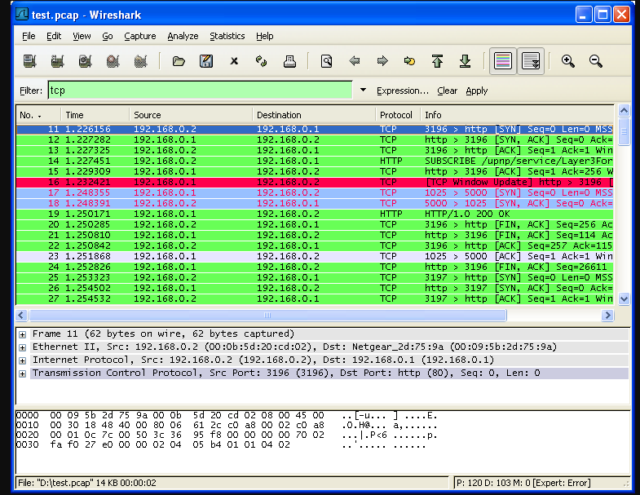
Network Programming Tools
1. Wireshark: Wireshark is a network protocol analyzer that allows developers to capture and inspect network traffic in real time. It is widely used for debugging network issues, analyzing packets, and monitoring network performance.

Slide 14
Let’s say you are a network administrator, and some users in your office are complaining that a website takes too long to load. You can open Wireshark on your computer, start capturing network packets, and then visit that website. Wireshark will show all the packets being sent and received.
You can see:
Which server the computer is connecting to.
How long each packet takes to travel.
Whether any packets are being lost or delayed.
After analyzing this, you might find out that the delay is due to a DNS lookup problem or too many retries caused by a faulty router.

Slide 15
2. Postman: Postman is a popular tool for API development and testing. It allows developers to send HTTP requests, test APIs, and automate workflows. Postman is widely used for debugging RESTful APIs, documenting endpoints, and ensuring the reliability of network applications.
3. Netcat: Netcat is one of the most powerful networking tools, security tools, and network monitoring tools. It is even considered a Swiss army knife of networking tools. It acts like a cat command over a network. It is generally used for the following reasons:
Operation related to TCP, UDP, or UNIX-domain sockets.
Port Scanning
Port Listening
Port redirection
open Remote connections
Read/Write data across the network.
Network debugging
Network daemon testing
Simple TCP proxies
A Socks or HTTP Proxy Command for ssh

Slide 16
4. Nmap: Nmap is a network discovery and security auditing tool. It is used to scan networks, identify open ports, and detect vulnerabilities. Nmap is widely used by network administrators and security professionals to assess network security and troubleshoot network issues.
Port Scanning is one of the features of Nmap wherein the tool detects the status of the ports on active hosts in a network. The status of the ports can be open, filtered, or closed. Type Nmap in the command line to run Nmap. Add necessary switches according to the scanning type to initiate a specific scan technique.
Example: nmap -sS 192.168.0.1-192.168.0.52
This command runs Nmap in TCP SYN scan type (-sS) and scans the given IP address range for active hosts and services.
5. cURL: cURL is a command-line tool for transferring data with URLs. It supports a wide range of protocols, including HTTP, FTP, and SMTP. cURL is commonly used for testing APIs, downloading files, and debugging network requests. Its simplicity and versatility make it a favorite among developers.
6. Telnet: Telnet is a protocol and tool used for remote login and communication. It is often used to test network services and debug servers. While Telnet is not secure, it remains a useful tool for troubleshooting and testing network connectivity.

Slide 17
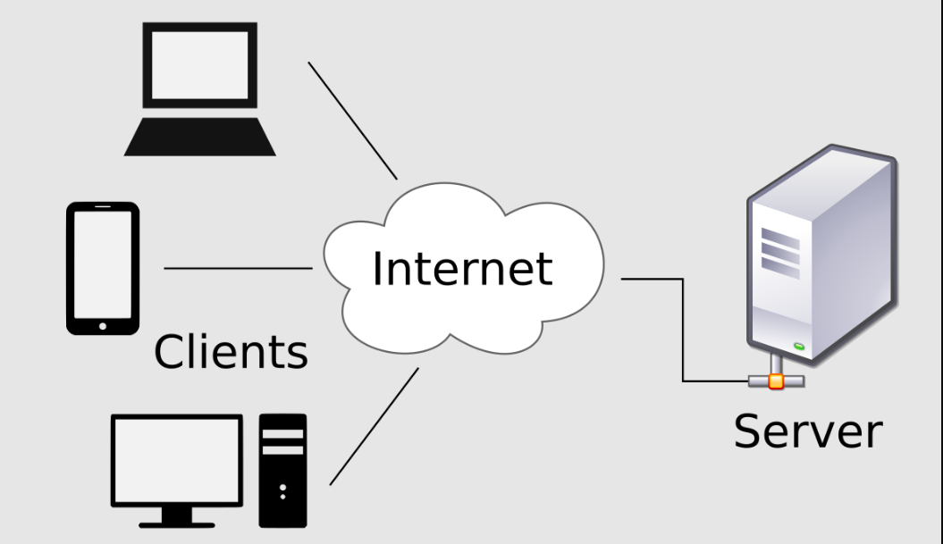
Client and Server Application

Slide 18
A client-server application is a software model where tasks are divided between clients (users or devices requesting services) and servers (machines or programs providing those services).
Example of client and server application
try{
ServerSocket Sscoket=new ServerSocket(5000);
System.out.println(“Server is Running....., waiting for client connection”);
Socket socket=Sscoket.accept();
OutPutStream output=socket.getOutPutStream();
PrintWriter witer=new PrintWriter(output,true);
writer.println(“Hello client”);
}
catch(IoException ex)
{
System.out.println(ex);}

Slide 19
client
try{
Socket socket =new Socket(“localhost”,5000);
inputStream input=socket.getInputStream();
BufferReader reader =new BufferReader(new InpurReaderStream(input));
String message=reader.readline();
System.out.println(message);
}catch(Exception ex){System.out.println(ex);
}

Slide 20
Advantage of Client and Server Application
1). Centralized Control
The fundamental benefit of a client-server network is that it allows for centralized management—all the information you can find in one place. Because the network administrator has complete control over management and administration, this is extremely advantageous. Any issue that arises throughout the whole network may be resolved in one location. It also becomes easier to upgrade data.
For example, if there is any problem or if an update is needed, it can be done directly on the server instead of changing it on every client computer. This makes management very simple and efficient.
2). Scalability: The system can be expanded easily by upgrading the central server to support more clients or heavier workloads without major changes to the overall network.
For instance, adding more memory or processing power to the server allows it to serve more clients without redesigning the whole system.
3).Enhanced security: Security protocols like authentication and data encryption can be implemented more easily on a central server.
4). Accessibility: Clients can access shared resources and services from any location, as long as they can connect to the server through the network or internet.

Slide 21
DisAdvantage of Client and Server Application
1). Server Dependency:
If the server fails, the entire system or network may stop working.
All clients depend heavily on the server’s availability.
For example, if the email server stops working, all users will be unable to send or receive emails until it is fixed.
2). High Cost:
Setting up and maintaining a powerful server can be expensive.
A powerful computer (server) is required to handle many clients, and it also needs proper hardware, software, and technical staff for maintenance.
3). Network Congestion: When many clients send requests to the server at the same time, it can create heavy traffic on the network. This slows down the communication between clients and the server, reducing overall performance.
4). Security Risks: Since all important data is stored on a single server, it becomes a major target for hackers or malware attacks. If the server’s security is breached, the entire network’s data can be at risk.
Therefore, strong security measures and regular updates are very important in a client–server system.

Slide 22
Network Programming Platform
Linux
Windows
MacOs
Cloud Platform
Docker

Slide 23
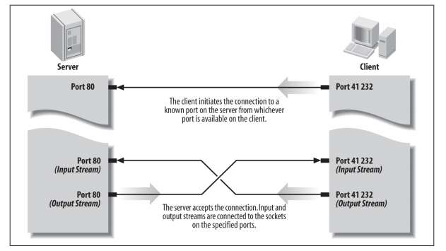
Client-Server Model
The client-server model is a fundamental software design principle where a client (a user-facing application like a web browser) requests services from a server, which is a powerful, centralized system that processes requests, manages data, and provides resources.

Slide 24
Design Considerations in client-server Software
Client-server software design is a structured approach to developing applications where tasks are divided between clients (user-facing applications) and servers (backend systems).
when designing a client-server application, you must consider:
1). Performance
Performance refers to how fast and efficiently a client–server system processes requests and responds to clients.
A well-designed system should balance the workload between the client and the server to prevent bottlenecks.
Key Points:
Balance the workload between client and server
Use caching and load balancing for heavy traffic

Slide 25
2). Security:
Security is one of the most critical design considerations in client–server applications.
It ensures that data and communication between client and server are protected from unauthorized access, attacks, and misuse.
3). Scalability:
Scalability refers to the ability of the system to handle an increasing number of users, data, or transactions without affecting performance.
A scalable system can grow easily as the demand increases.
4). Reliability:
Reliability ensures that the system continues to function correctly even when parts of it fail.
A reliable client–server application should be able to detect errors, recover from failures, and maintain continuous service.

Slide 26
5). Maintainability
Maintainability means how easily a system can be updated, debugged, or improved after deployment.
A maintainable system is easier to extend, test, and manage over time.

